Slide 1
CS7/8745 : Machine Learning Instructor: Salim Sazzed Department of Computer Science University of Memphis

Slide 2
Data for machine learning

Slide 3
Data Modalities
In machine learning, "modalities" refer to different types or modes of data, each representing a distinct aspect of information.

Slide 4
Text Modality
Text data includes natural language text in the form of documents, articles, reviews, and more.
Documents:
Social Media Posts:
Web Pages:
Emails:
Reviews:
News Articles:
Medical Records:
Legal Documents:
Chat Logs
Natural Language Processing (NLP) techniques are used to process and analyze text data.

Slide 5
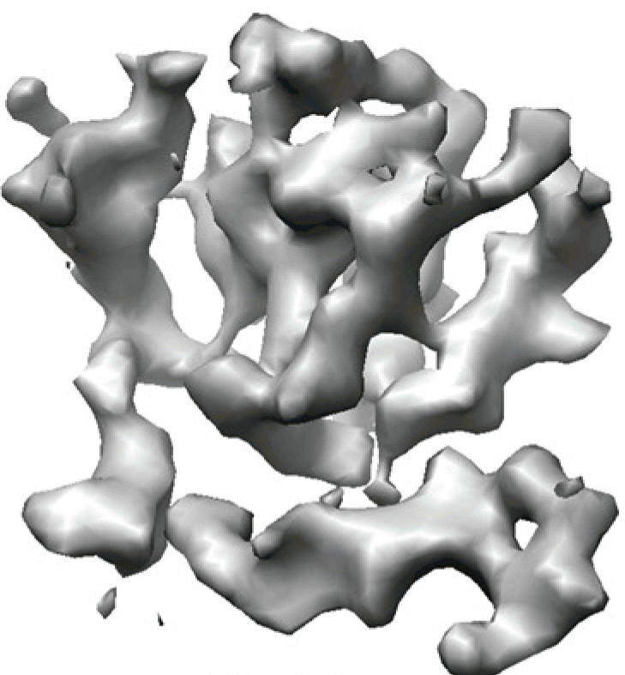

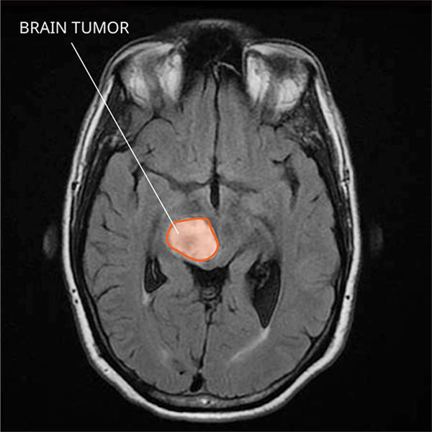
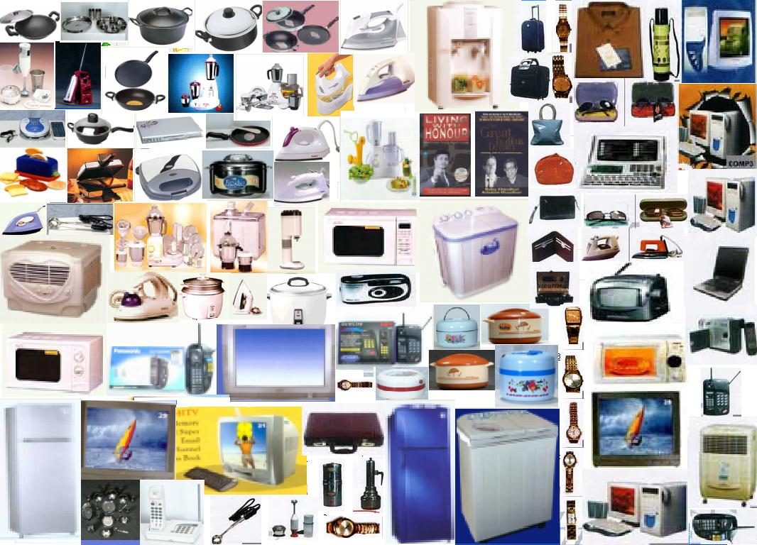
Image Modality
Biological data
Remote sensing data (taken from satellite/drone)
Image data consists of visual information, typically in the form of 2D or 3D arrays of pixels.
Convolutional Neural Networks (CNNs) are commonly used to analyze and extract features from image data.
Ecommerce product data
medical imaging data

Slide 6
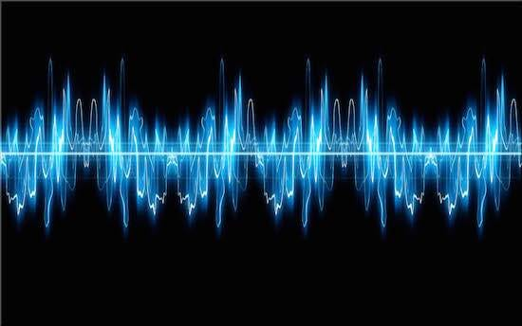
Audio/Speech Modality
Audio data represents sound information, often recorded as waveforms.
Techniques such as spectrogram analysis and audio processing are used for feature extraction and analysis.

Slide 7
Time Series Modality:
Time series data is collected or recorded over time at regular intervals.
Each data point in a time series is associated with a specific timestamp or time period, making it a sequence of data points ordered chronologically.
Time series data is widely used in various fields, including finance, economics, environmental science, engineering, and more, to analyze and make predictions based on temporal patterns and trends.
Financial Forecasting: Predicting stock prices, currency exchange rates, and economic indicators.
Demand Forecasting: Forecasting product demand for inventory management.
Environmental Monitoring: Analyzing temperature, humidity, pollution levels, and weather patterns over time.
Energy Consumption: Modeling and predicting electricity and energy usage.
Healthcare: Monitoring patient vital signs and disease progression.
Industrial Processes: Monitoring and optimizing manufacturing processes.
Traffic and Transportation:

Slide 8
Data Organization and Format
Structured data, semi-structured data, and unstructured data represent different levels of organization and format in data.
They are used to describe how data is stored, managed, and processed.

Slide 9
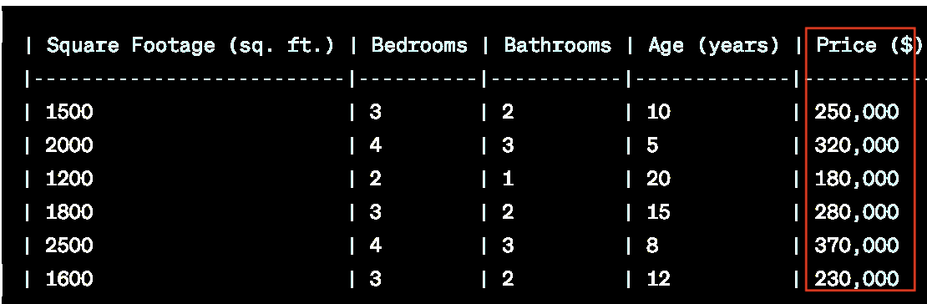
Structured Data:
Definition: Structured data is data that is highly organized and follows a predefined schema or structure.
Characteristics:
It is typically stored in tabular form, with rows and columns.
Each column represents a specific attribute or field, and each row represents a single record or entry.
The data values in each cell adhere to a specific data type (e.g., integers, strings, dates).
Examples:
Relational databases, where data is stored in tables with defined schemas.
Spreadsheets like Microsoft Excel or Google Sheets.
CSV files and SQL databases.
Use Cases:
It is suitable for scenarios where data is well-organized and can be easily queried and analyzed using SQL or other structured query languages.

Slide 10
Semi-Structured Data:
Definition: Semi-structured data is data that does not conform to a strict, predefined structure like structured data but has some level of inherent structure or organization.
Characteristics:
It may not be stored in tables, but it still has a logical structure that can be leveraged.
Semi-structured data often uses flexible formats like JSON, XML, or key-value pairs.
Data elements may be nested or hierarchical, allowing for complex data relationships.
Field names or tags are used to identify data elements.
Examples:
JSON (JavaScript Object Notation) documents, which contain nested key-value pairs.
XML files that use tags to organize data hierarchically.
NoSQL databases like MongoDB, which store data in flexible, document-like structures.
Use Cases:
Semi-structured data is well-suited for scenarios where data can vary in structure or where a dynamic schema is required.
It is often used in web applications, data interchange formats, and unstructured text with some inherent structure.

Slide 11
Unstructured Data:
Definition: Unstructured data is data that lacks a specific structure or format. It does not fit neatly into tables or predefined schemas.
Characteristics:
It includes text, images, audio, and other types of data that do not have a fixed structure.
Natural language text, images, and multimedia content are typical examples.
Examples:
Text documents (e.g., PDFs, Word documents) with no specific structure.
Image files, videos, and audio recordings.
Social media posts, chat logs, and email content.
Use Cases:
Unstructured data is common in scenarios where human language and creativity are involved.
Natural Language Processing (NLP) and computer vision techniques are used to extract meaning and insights from unstructured data.
Use cases include sentiment analysis, image recognition, and content categorization.
https://www.youtube.com/watch?v=aQVDhxE1-sE
https://www.youtube.com/watch?v=cYlzIeXAAtI

Slide 12
Numerical and categorical are two primary types of variables in statistics and data analysis.
Numerical Variables: represent quantities that can be measured on a continuous or discrete scale.
Examples: Age, height, weight, temperature, income, number of children, etc.
They have an order or meaningful relationship between values. For example, if one person is 10 years old and another is 20 years old, we know the second person is older.
They can be continuous (e.g., height measured in inches) or discrete (e.g., number of siblings)

Slide 13
Categorical Variables: Categorical variables represent categories or labels. They do not have a natural order or numerical interpretation.
Examples: Gender, color, marital status, types of fruits, etc.
Properties:
They represent distinct categories or groups.
There is no meaningful way to perform arithmetic operations on categorical variables.
Representation: Categorical variables are often represented using labels or codes. For example, "Male" and "Female" for gender, or "Red," "Blue," and "Green" for colors.

Slide 14
Data Cleaning
Real-world data has-
Missing values: data collection errors, incomplete records, etc.
Inconsistent data: human data entry errors, measurement errors, or discrepancies between data sources.
Outliers: Outliers are data points that deviate significantly from the majority of the data and can distort statistical analyses and machine learning models.

Slide 15
Missing Data
Example: Predicting House Prices
Suppose you are working on a machine learning project to predict house prices based on various features. You have a dataset that includes the following features:
Square Footage: The size of the house in square feet.
Number of Bedrooms: The number of bedrooms in the house.
Number of Bathrooms: The number of bathrooms in the house.
Year Built: The year the house was built.
Garage Size: The size of the garage in square feet.
Year Built: Data on the year a house was built might be missing for very old or very new properties, especially if it was not properly recorded.
Garage Size: Houses without garages will have missing values for this feature. Not all houses have garages.
Number of Bedrooms or Number of Bathrooms: In some cases, this information may be missing due to errors in data entry or because the house is unconventional (e.g., a studio apartment with no distinct bedrooms).

Slide 16
Inconsistent Data
Inconsistent data refers to data that is contradictory, conflicting, or doesn't conform to expected patterns or rules within a dataset. Here are some examples of inconsistent data:
1. Inconsistent Date Formats: In a dataset containing dates, some entries might use different date formats (e.g., MM/DD/YYYY and DD-MM-YYYY) instead of adhering to a consistent format.
2. Inconsistent Units: A dataset might have some values in meters and others in feet without clear conversions.
3. Out-of-Range Values: For example, a temperature reading of -500°C would be inconsistent in most contexts.
4. Data Entry Errors: Typos or data entry errors can lead to inconsistencies. For example, a product's weight might be recorded as 150 lbs in one place and 105 lbs in another.

Slide 17
Addressing Data Issues
Fill in missing values, smooth noisy data, identify or remove outliers, and resolve inconsistencies

Slide 18
How to Handle Missing Data?
Ignore the tuple/sample: usually done when class label is missing (assuming the task is classification—not effective in certain cases)
Fill in the missing value manually (guessing/based on experience): tedious + infeasible?
Use a global constant (e.g., -1, ‘NA’, ‘Unknown’) to fill in the missing value: e.g., “unknown”, a new class?!
Use the attribute mean to fill in the missing value
Use the attribute mean for all samples of the same class to fill in the missing value: smarter.
Use the most probable value to fill in the missing value: inference-based such as regression, Bayesian formula, decision tree.
Slides modified from: Vasileios Megalooikonomou, Temple University

Slide 19
Other ways…..
Most Frequent Value
K-Nearest Neighbors: The objective is to find the k nearest(similar) examples in the data where the value in the relevant feature is not absent and then substitute the value of the feature that occurs most frequently in the group.

Slide 20
Data with numerical attribute’s value missing
1. Use attribute mean to fill in the missing value-
2. Use the attribute mean for all samples of the same class to fill in the missing value.
Sample | Feature 1 | Feature 2 | Class
1 | 3.2 | 5.1 | A
2 | 2.8 |  | B
3 | 4.5 | 6.7 | A
4 |  | 5.4 | B
5 | 2.7 | 4.3 | A
6 | 4.0 |  | B
7 | 3.6 | 5.8 | A
8 |  | 4.8 | B
9 | 3.8 | 6.0 | A
10 | 3.0 |  | B

Slide 21
Data with categorical attribute’s value missing
Sample | Category 1 | Category 2 | Class
1 | Red | High | A
2 | Blue |  | A
3 | Green | Medium | B
4 | Yellow | Low | B
5 |  | Low | A
6 | Green |  | B
7 | Yellow | High | A
8 |  | Medium | B
9 | Blue | High | A
10 | Yellow | High | B
Most frequent value
Most frequent value of same class

Slide 22
Data Transformation
Normalization:
Data normalization, rescale numerical features to a common scale (0 to 1, -1 to +1).
Normalization ensures that all numerical features have similar scales, so they don't dominate or bias the learning algorithms.
Normalization is especially important for machine learning algorithms that rely on distance metrics, such as k-nearest neighbors (KNN) and support vector machines (SVM), and for deep learning neural networks.
Min-max normalization
Z-score normalization

Slide 23
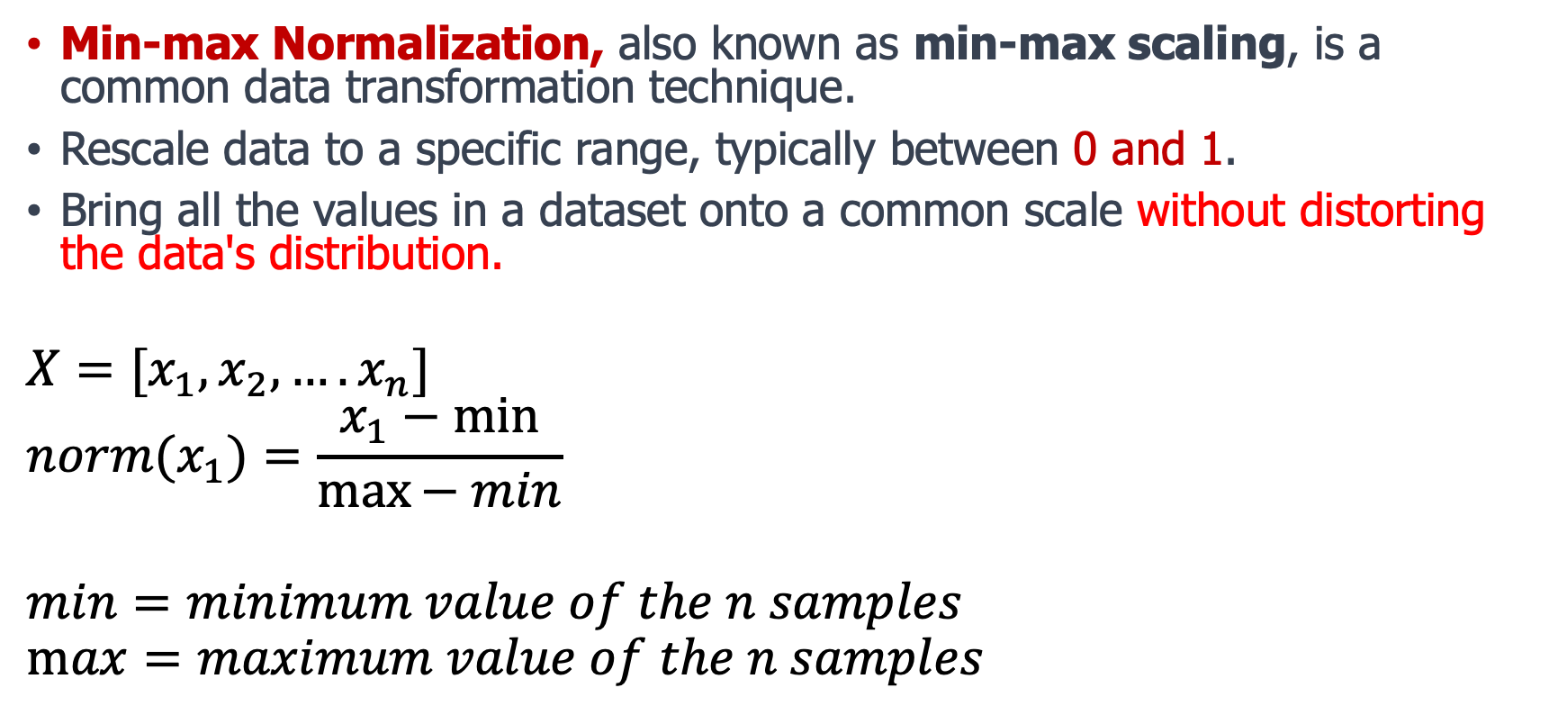
Min-max normalization:
Min-max Normalization, also known as min-max scaling, is a common data transformation technique.
Rescale data to a specific range, typically between 0 and 1.
Bring all the values in a dataset onto a common scale without distorting the data's distribution.
$$X=[x_{1},x_{2},….x_{n}]$$
$${norm(x}_{1})=\frac{x_{1}−min}{\max{− min}}⁡$$
$$min=minimum value of the n samples$$
$$\max{=maximum value of the n samples }$$

Slide 24
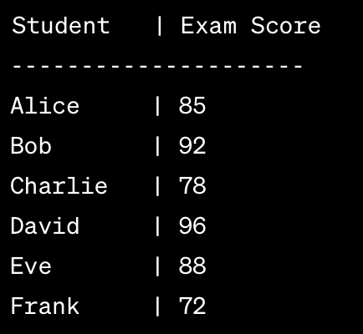
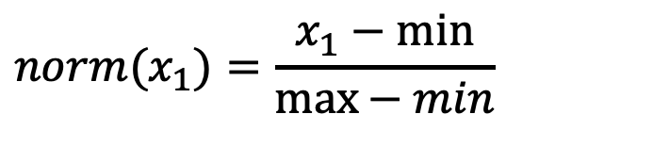
Compute normalized exam scores for all students
$${norm(x}_{1})=\frac{x_{1}−min}{\max{− min}}⁡$$

Slide 25
For Alice: (85 - 72) / (96 - 72) = ?
For Bob: (92 - 72) / (96 - 72) = ?
For Charlie: (78 - 72) / (96 - 72) = 0.25
For David: (96 - 72) / (96 - 72) = 1.0000
For Eve: (88 - 72) / (96 - 72) =
For Frank: (72 - 72) / (96 - 72) = 0.0000
The Min-max normalization technique scales the data linearly, preserving the relative differences between values while bringing them into the desired range.
This can be useful in various machine learning algorithms and data analysis tasks, especially when different features or variables have different units or scales.

